Slide 1
Lesson 2 – The Sun’s Magic
Farming & Our Food - A Grade 2 Water Cycle Unit
This lesson was created by Grain Farmers of Ontario to be used by Ontario educators in the classrooms. For any questions or concerns regarding use please contact bcurtis@gfo.ca

Slide 2
These lessons are designed to empower you in leading engaging, hands-on STEAM activities that directly connect with the Ontario Science curriculum. We understand that every classroom is unique, so each lesson offers a variety of options for implementation. Choose the approach that best suits your students and learning environment.
Notes:
Educator Notes:
This is the second lesson in the unit, building on the understanding of water's states.
The focus is on the process of evaporation and its direct relevance to farming, especially grain farming.
Encourage students to make connections in their everyday lives.

Slide 3

Lesson Overview
What We'll Explore: Water Disappearing
Learning Goal:
Students will be able to explain evaporation as the process of liquid water turning into invisible gas (water vapour) and rising into the air, primarily due to the sun's heat.
Curriculum Connections:
Overall: E2. demonstrate an understanding of the properties of air and water, including water in various states, and of ways in which living things depend on air and water for their survival.
Specific: E2.3 describe the stages of the water cycle, including evaporation, condensation, precipitation, and collection.
Specific: E2.4 identify the three states of water in the environment, and describe how temperature changes affect the state of water within the water cycle.
Key Concepts:
Evaporation
Water Vapour (gas)
Sun's heat
Soil moisture
Notes:
Educator Notes:
Clearly state the learning objective for students.
Highlight the specific curriculum expectations covered in this lesson.
Emphasize the sun's role as the energy source for evaporation.
Reinforce the importance of water in the soil for grain crops.

Slide 4
Materials & Activity
Getting Ready: Materials & Your Choices
General Materials Needed:
Chart paper or Whiteboard, markers
Slide show
Small sponges or squirt bottles with water
Chalk (outside) or Whiteboard markers/liquid chalk markers (inside) for outlining water art
Option 1: Common Materials - Water Art & Farm Evaporation
Focus: Hands-on observation of evaporation on different surfaces, connecting to farm fields.
Additional Materials: Outdoor - paved area or Indoors - a large dark surface (e.g., a dark ceramic tile, small plastic lid, or a section of a chalkboard/Whiteboard
Option 2: Slightly More Complex - Student-Led Soil Type & Evaporation
Focus: Investigating how different soil types affect evaporation and water retention for crops.
Additional Materials: Two shallow trays (one per group), two types of soil (e.g., sand and potting soil/clay soil), small watering can, measuring cups.
Notes:
Educator Notes:
Educators - choose the option that best suits your classroom resources and student needs.
For Option 1, ensure the chosen surface is non-absorbent for clear observation of evaporation.
For Option 2, other options for soil: might include small rocks or pebbles if sand is not available

Slide 5
Minds On
Notes:
(10-15 minutes)
Educator Notes:
Purpose: To connect prior observations to the concept of evaporation and introduce its importance in farming.
Tips: Encourage students to share their hypotheses about where the water goes. Use simple language to explain "invisible gas" (water vapour).
Farming Link: Directly link the concept of evaporation to a grain farmer's field and the need for soil moisture for plant growth.

Slide 6
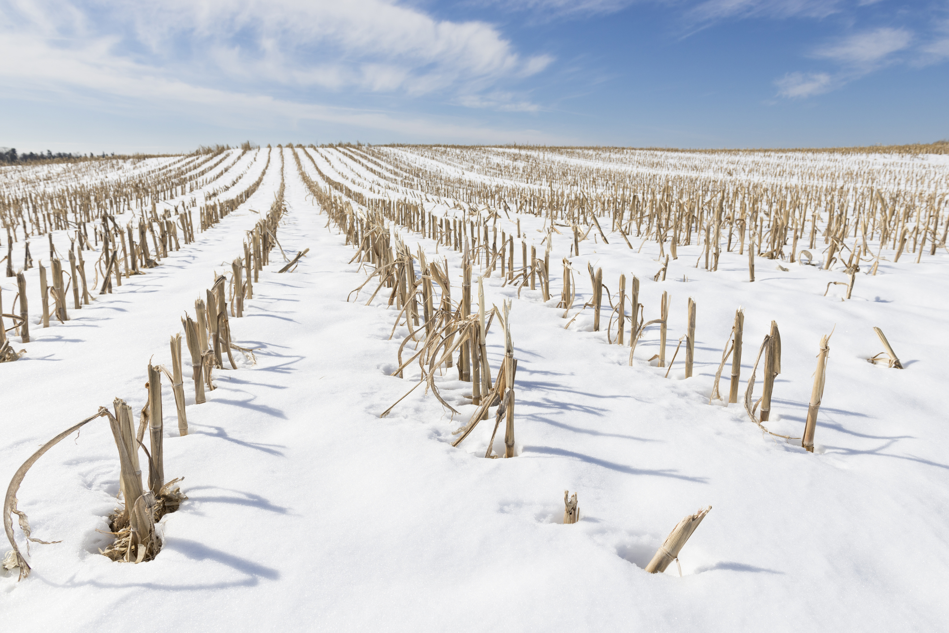
Do you remember the
disappearing water from lesson 1?
Notes:
Educator Notes:
Recall "Disappearing" Water: Begin by referencing the "disappearing" water from Lesson 1 (i.e., the puddle on the dark surface) Remember how the water on the warm plate/surface seemed to disappear? Where do you think it went?

Slide 7
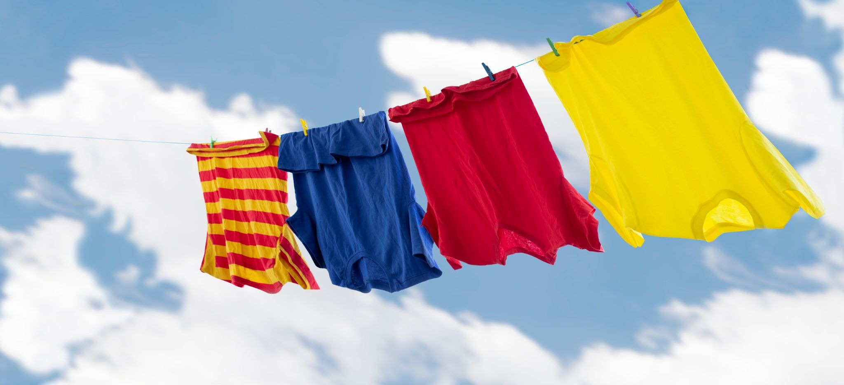
What is happening to
the water in this picture?
Notes:
Educator Notes:
Real-World Examples: Display the pictures of wet clothes drying on a line . Ask: "Where is the water in this picture?” (on the wet clothes) “What is happening to the water here?” (take a variety of student answers)

Slide 8
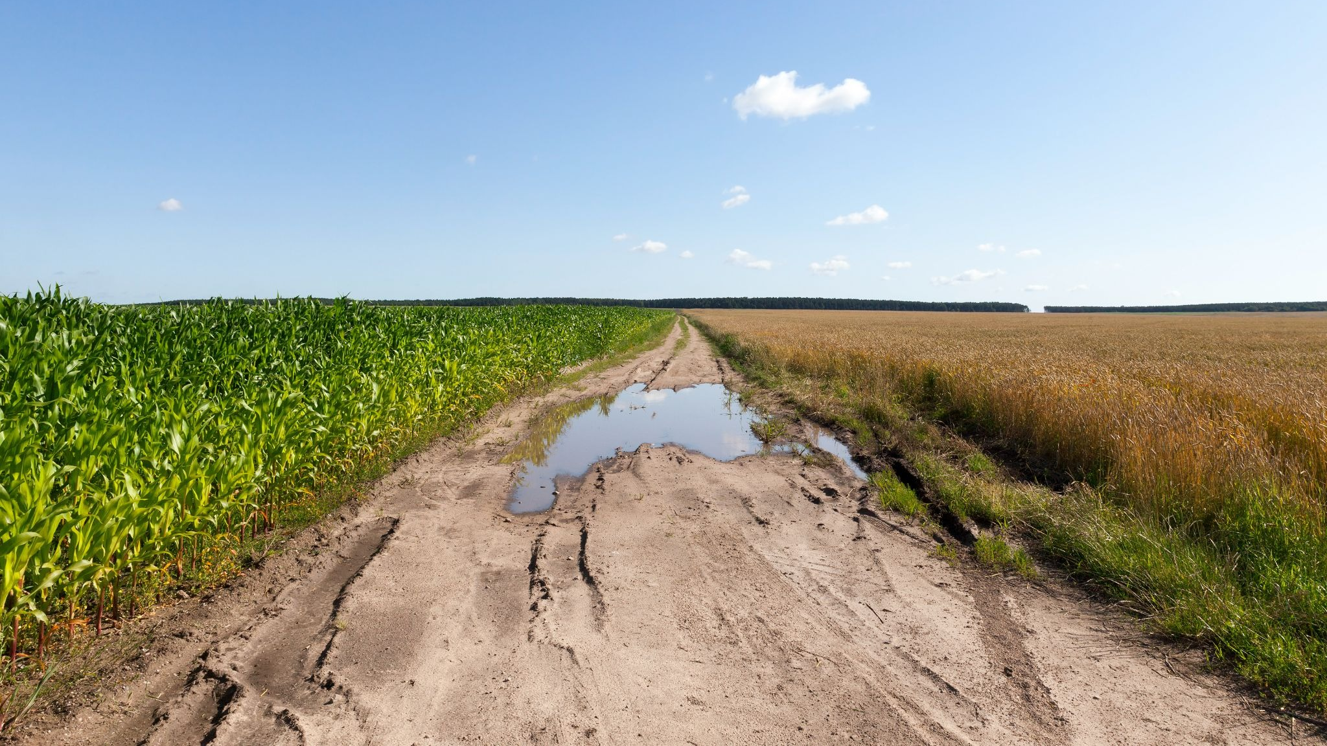
What is happening to
What is happening to the
the water in this picture?
water in this picture?
Notes:
Educator Notes:
Real-World Examples: Display the picture of a puddle shrinking on a sunny day. Ask: "What is happening to the water here?"

Slide 9
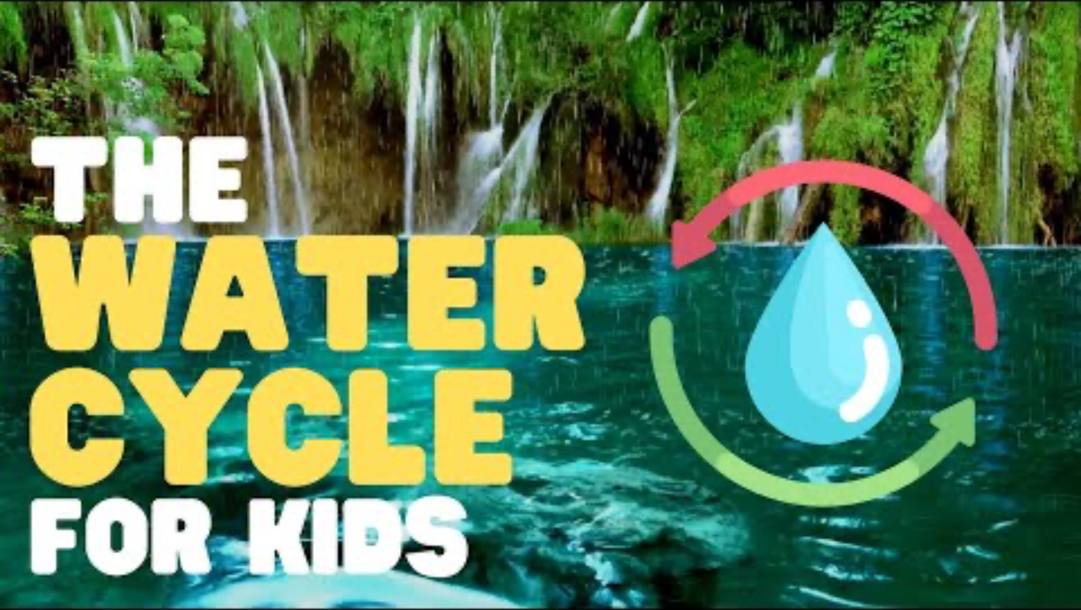
What is Evaporation?
Notes:
Introduce Evaporation: Introduce the term "evaporation" as the process where liquid water turns into an invisible gas (water vapour) and goes up into the air. Emphasize that the sun's heat provides the energy for this, just like the water on the warm plate/surface. This video is edited to focus only on the evaporation portion of the water cycle.
Video source from: https://www.youtube.com/watch?v=TD3XSIE4ymo

Slide 10
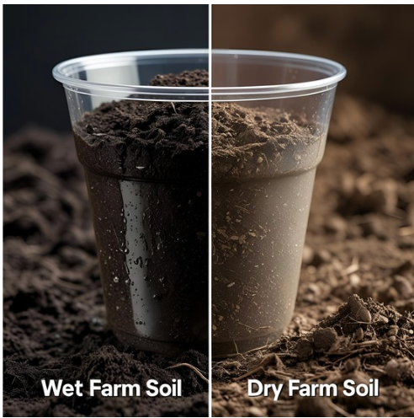
Imagine
This cup is part of a grain field after it rains!
The same amount of soil is in both sides.
One side gets water like rain. The other stays dry.
Think
If the sun shines on the wet soil all day, what do you think will happen to the water?
Why is it super important for farmers that some water stays deep in the soil for their plants to drink?
Notes:
Educator Notes:
"Imagine these cups are parts of a grain field after it rains. The same amount of soil is in both. In one, we'll add water like rain. The other will stay dry."
"What do you think will happen to the water in the wet soil if the sun shines on it all day?" Allow predictions - some possible answers might be:
Over time, the water seems to disappear!
This is called Evaporation!
“Over time, the water seems to disappear! That's evaporation. Why is it so important for a grain farmer that not all the water evaporates and some water stays deep in the soil for the plants to drink?” (Guide them to understand roots need water to grow.)
The key message: Emphasize that while evaporation is natural, farmers work with their soil so that it is healthy and can retain enough water in the soil for their grain crops to thrive. How? Read more https://goodineverygrain.ca/2024/02/29/sustainable-farming-starts-with-soil/
You can refer to the Grain Farmers of Ontario / Good in Every Grain. "Sustainability on the Farm." resource (Source: https://gfo.ca/market-development-and-sustainability/sustainability-on-the-farm/).
This resource highlights that most Ontario grain farming is "rain-fed," meaning farmers rely on rain soaking into the soil. It also discusses practices like planting "cover crops," which help the soil hold onto water, directly addressing the importance of water staying in the soil for crop growth. Farmers use these practices to help the soil act like a sponge.

Slide 11
Action

Slide 12
Option 1:
Farm Puddles & Evaporation Art
Notes:
(15-25 minutes)
Educator Notes:
This activity is best outside on a sunny day, but can be done inside too (see variations).
Scaffolding: Encourage students to draw farm-related shapes or scenes with their water art. Guide them to actively observe the shrinking water.
Differentiation: For students who finish early, challenge them to draw what they think the invisible water vapour looks like as it rises or have them make moFarming Connection: Emphasize how farmers observe evaporation on their fields and use practices to help soil retain moisture for grain crops. re water art.

Slide 13
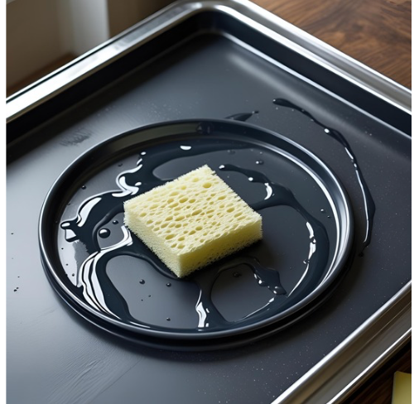
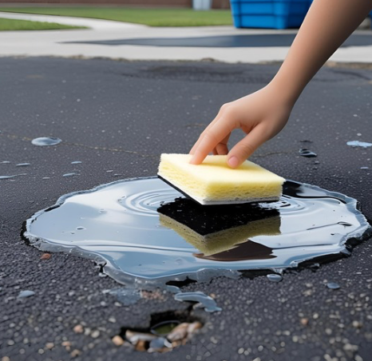
1. Let’s Make A Puddle
Create your own puddle, imagine this is a puddle found on the farm.
Notes:
Educator Notes:
Activity Steps (for students):
Hands On Water Art Experiment (Indoor Friendly!):
Provide each student or small group with a dark-coloured, non-absorbent surface (e.g., a dark ceramic tile, small plastic lid, or a section of a chalkboard/Whiteboard).
Give them a small sponge or dropper with water.
Instruct them to create their own "water art" on the surface, imagining they are drawing "puddles" in a farm yard or field.
Hands-On Water Art Experiment (Outdoor Friendly!):
Take students outside to a paved area.
Give each student a small sponge or squirt bottle with water.
Instruct them to create their own "water art" on the surface, imagining they are drawing "puddles" in a farm field.

Slide 14
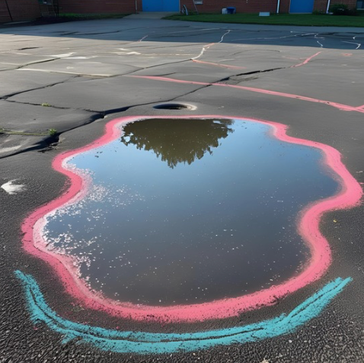
2. The Puddle Evaporates
What is happening to your water art? Why is it disappearing?
Outline your puddle
Bonus - Can you make your puddle art look like something you might find on a farm?
Notes:
Educator Notes:
After creating, have students observe their own art over time. To speed up evaporation indoors (or even outdoors too), encourage them to gently fan their surface with their hand or a piece of paper, or place their surface under a bright lamp.
Discuss: "What is happening to your water art? Why is it disappearing?" (If possible, have them outline their art with chalk before it disappears to see the change more clearly).
Encourage students to outline their art with chalk before it disappears to see the change more clearly. If outdoors chalk is a great material to outline with. If indoors you might use dry erase markers (or if possible liquid chalk markers or even small paint tubes).

Slide 15
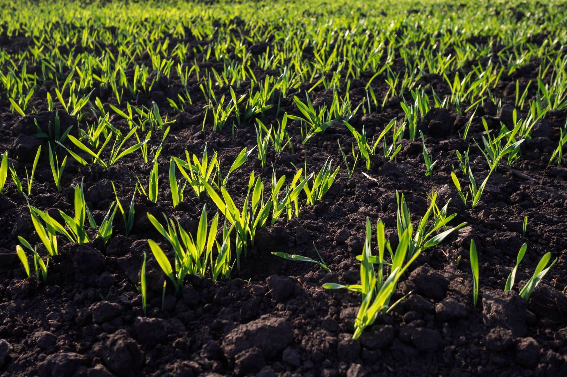
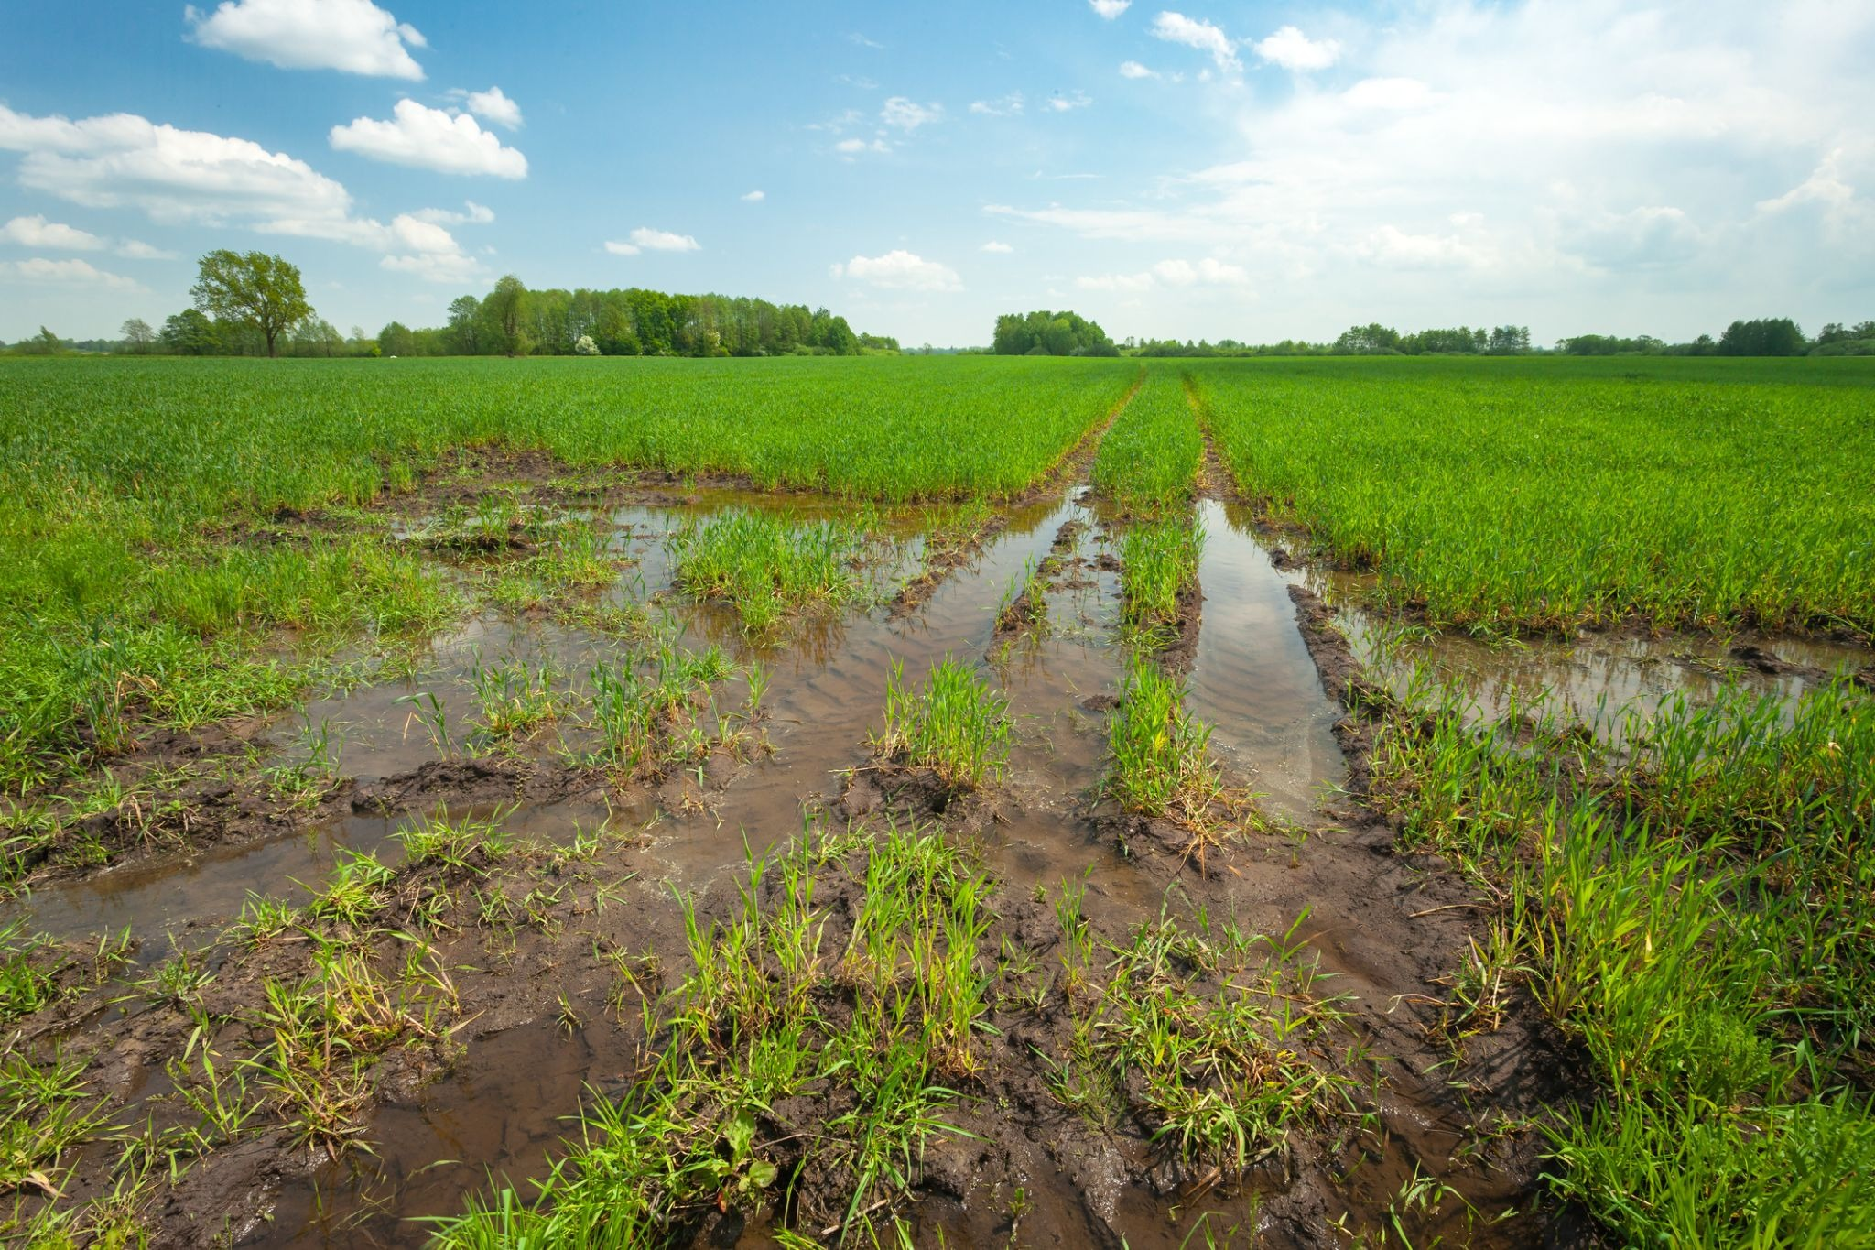
3. The Point Is:
Hard ground doesn’t drink in the water. So it evaporates fast, or flows off the ground.
Healthy farm soil is like a sponge! It soaks up water and holds it tight for the plants.
Notes:
Educator Notes:
Farmer's Challenge Discussion: Explain that while evaporation is a natural part of the water cycle, grain farmers want the right amount of water to stay in the soil for their plants to grow. Discuss how hard surfaces (like compacted soil in the first image (this compaction may have been caused by a lot of traffic from heavy tractors)) let water run off or evaporate quickly and not soak into the ground, but healthy farm soil can hold water like a sponge (and it soaks into the ground vs. laying on top or evaporating) Farmers use practices like "no-till" or "zero-till" farming (https://canadianfoodfocus.org/on-the-farm/water-the-most-precious-on-farm-natural-resource/ ), which means they don't dig up the soil as much, helping the soil hold onto water better. The top layer of soil acts like a "blanket" to keep the water in the soil from evaporating too quickly, so the grain plants have enough to drink.
More about this will follow on slides 20 – 22.

Slide 16
Option 2:
Soil Secrets & Evaporation!
Notes:
Educator Notes:
Scaffolding: Provide clear labels for the soil types. Encourage students to make predictions before the experiment.
Accuracy: Ensure the amount of water poured into each tray is consistent for a fair comparison.
Farming Connection: This activity directly links soil properties to water retention and evaporation, crucial for grain farming. Emphasize that farmers apply scientific understanding to manage their fields for optimal water use.
Resources for Grain Farming Water Cycle:
Grain Farmers of Ontario - "Sustainability on the Farm": This resource discusses rain-fed agriculture, soil health, and cover crops, directly relevant to managing evaporation for grain crops. (Source: https://gfo.ca/market-development-and-sustainability/sustainability-on-the-farm/)
Canadian Food Focus - "Water: The Most Precious On-Farm Natural Resource": This resource discusses soil moisture retention and zero-till practices that reduce evaporation. (Source: https://canadianfoodfocus.org/on-the-farm/water-the-most-precious-on-farm-natural-resource/)
Ontario.ca (Ministry of Agriculture, Food and Agribusiness) - "Water management in agriculture": General information on water management practices in Ontario agriculture. (Source: https://www.ontario.ca/page/water-management-agriculture)

Slide 17
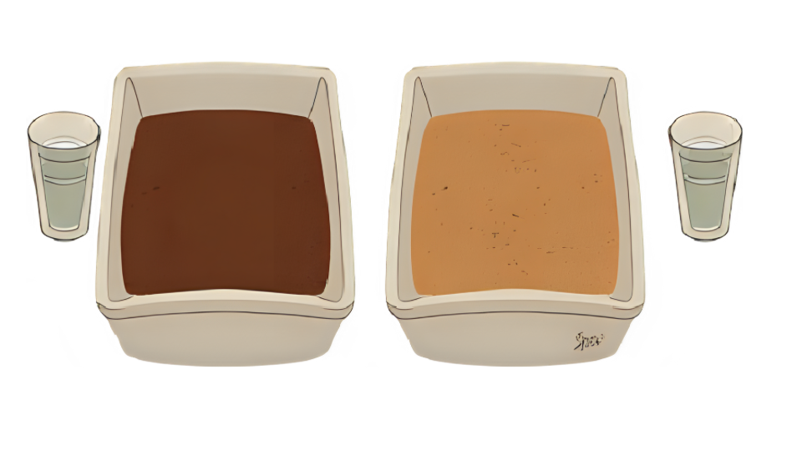
Let’s Begin Our Soil Experiment
You will need:
2 shallow trays
Sand and clay rich soil (like potting soil)
Measuring cup to ensure equal water distribution to both trays
Notes:
Educator Notes:
Student-Set Up Soil Evaporation Experiment: Divide students into small groups. Provide each group with two shallow trays, one with sandy soil and the other with potting soil (or a clay-rich soil). Have them carefully pour the same measured amount of water (e.g., 1 cup) into each tray, ensuring the soil is evenly damp.

Slide 18
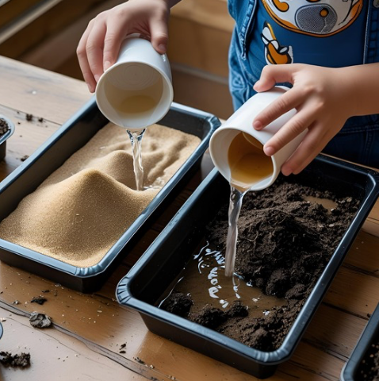
1. Your Turn!
Add Water: Carefully pour the same amount of water (like 1/4 cup) into each tray.
Make it Damp: Make sure the soil in both trays gets nice and wet all over
Notes:
Educator Notes:
Student-Set Up Soil Evaporation Experiment: Have students carefully pour the same measured amount of water (e.g., 1/4 cup) into each tray, ensuring the soil is evenly damp.

Slide 19
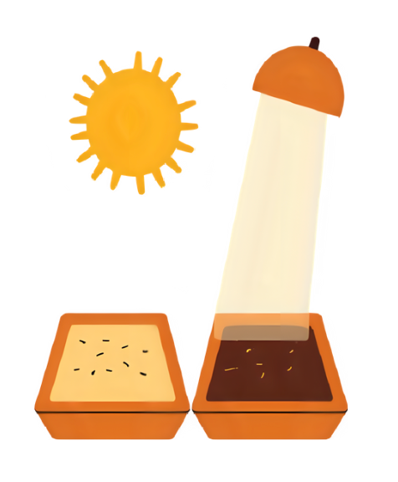
2. Let’s Add Some Sun (or Light)
Find a Sunny Spot: Put both of your soil trays in a sunny window or right under a bright lamp.
Watch Closely: Check your trays every day! Which tray's soil gets dry first?
Draw or Write: In your science notebook, draw what you see or write down what happens to the water in each tray.
Notes:
Educator Notes:
Observe & Record: Have each group place both of their trays in a sunny spot or under a lamp. Students will observe and record which tray's surface dries out faster over time. They can draw, discuss or write their observations.

Slide 20
Connect to Farming
Notes:
Educator Notes:
This connection can be made after completing Action Option 1 or Option 2

Slide 21
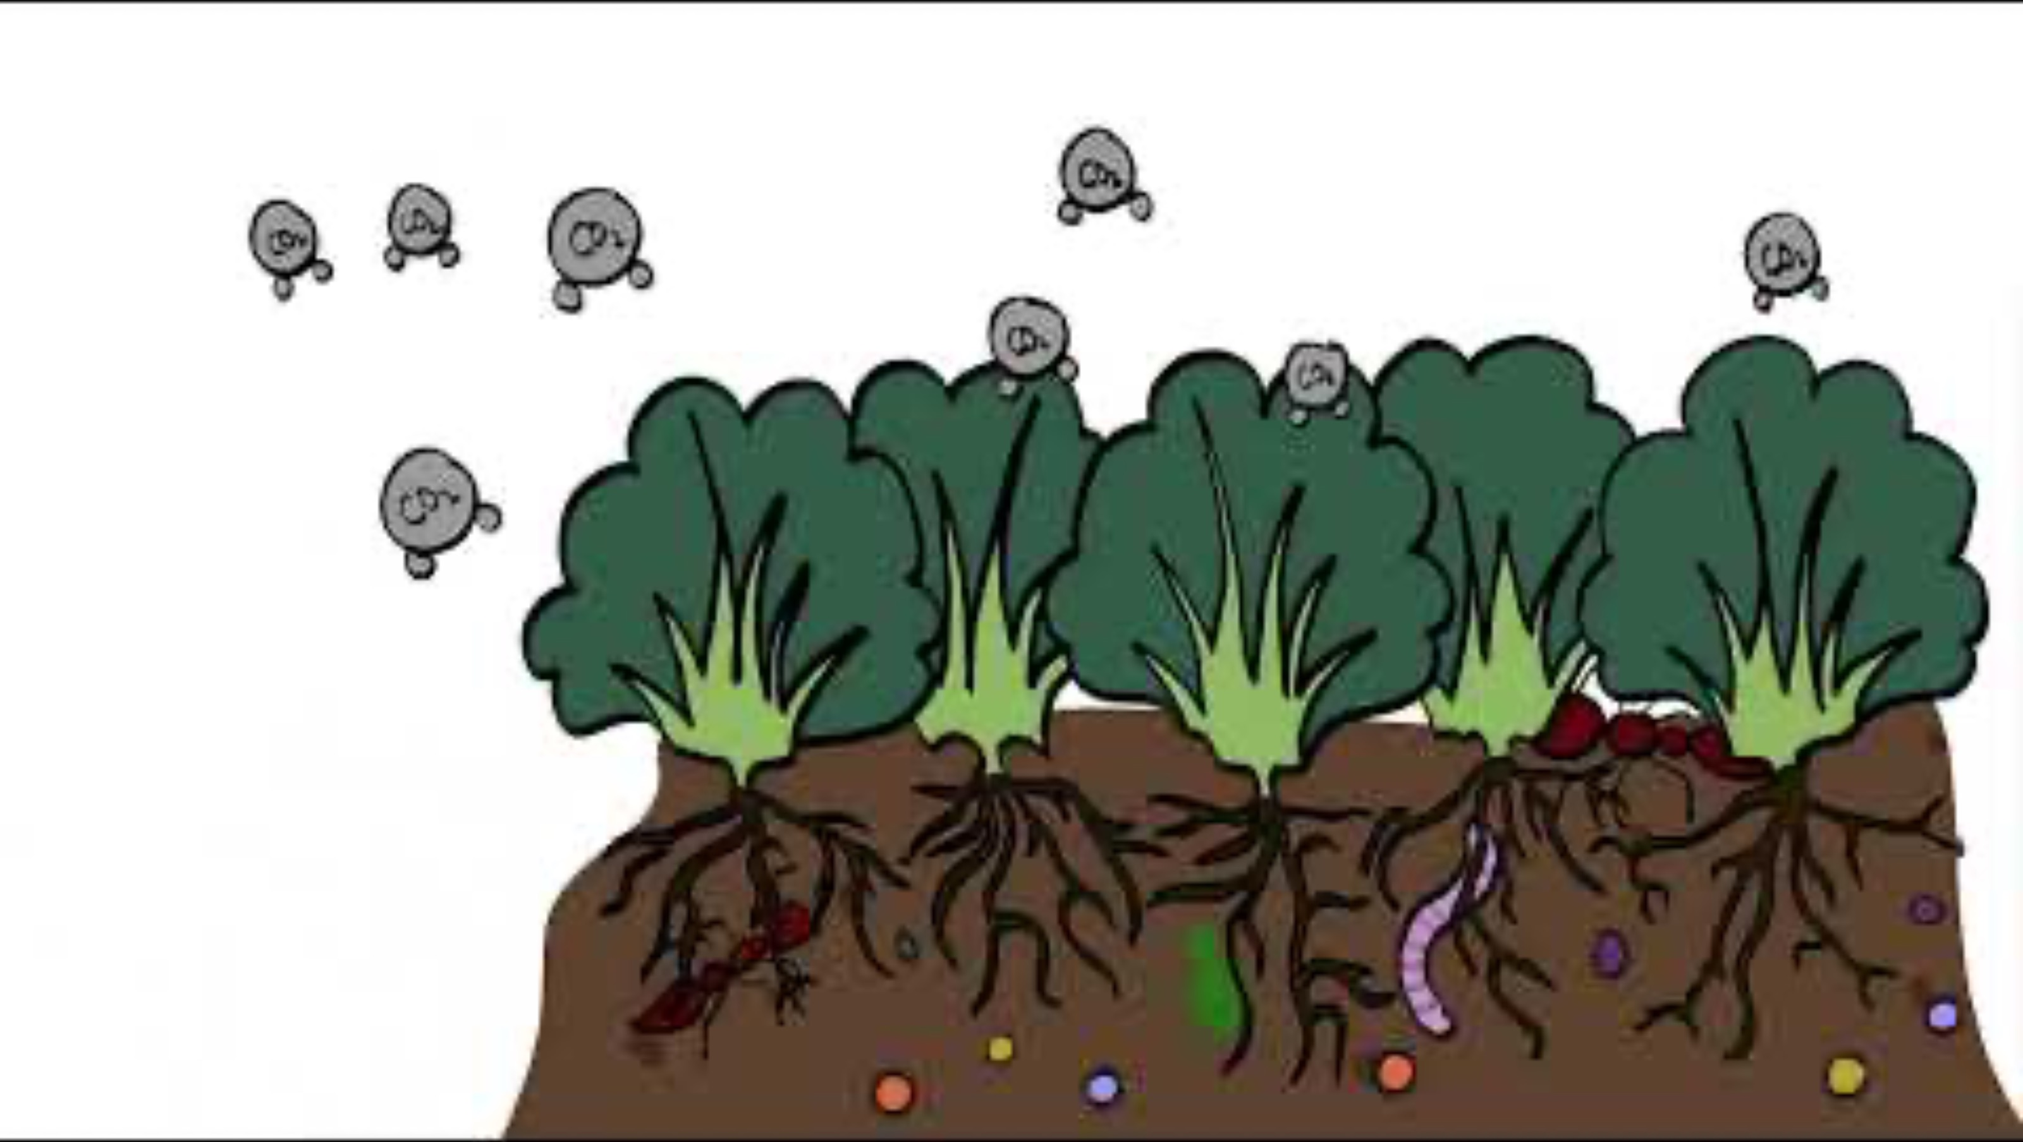
Connect to Farming:
Soil's Green Blanket: Cover Crops!
Guess what? Farmers have another smart trick to keep water in their soil!
They plant special "helper" plants called Cover Crops.
Notes:
Educator Notes:
Educator tip: When introducing "Cover Crops," emphasize the idea of a "green blanket" as a simple, visual metaphor for Grade 2 students. You can ask students to imagine what a blanket does for them (keeps them warm/dry and connect that to how the cover crops keep the soil's water from disappearing.
Resources: https://gfo.ca/market-development-and-sustainability/sustainability-on-the-farm/
Video resource: https://www.youtube.com/watch?v=aVgk0-upkKc
*note this video calls corn and wheat as Cash Crops which is a jargon term for grain crops.

Slide 22
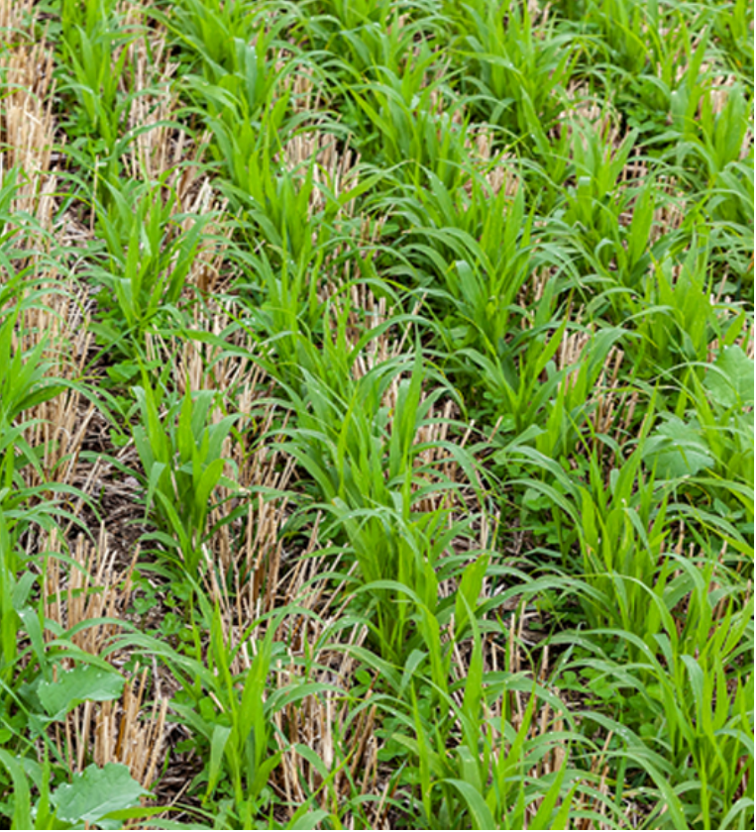
Cover Crops
These helper plants grow like a green blanket over the soil.
The green blanket helps stop the water from disappearing into the air!
It keeps the soil nice and moist for the next big plants to grow.
This is a super way to keep our farm soil healthy and happy!
In this picture an Ontario farmer planted radishes in their wheat field to make a cozy radish blanket.
Notes:
Educator Notes:
Resources: https://ontariograinfarmer.ca/2022/02/01/cover-crops-in-ontario/

Slide 23
Consolidation
Notes:
Educator Notes:
Purpose: To review key concepts and assess student understanding of evaporation's role in the water cycle and farming.
Assessment: The drawing serves as a formative assessment. Look for correct labeling and clear representation of evaporation in a farm context.
Differentiation: For students who need more support, provide sentence starters for their explanation or pre-drawn outlines for their drawing. For advanced learners, ask them to explain how wind might affect evaporation.

Slide 24
Discussion
We've learned that water can sometimes disappear from the soil. Why do you think it's super important for farmers to try and keep water in the soil for their plants, so we can have the food we eat?
Notes:
Educator Notes:
You could use the consolidation questions as a formative assessment or use the provided Lesson 2 exit ticket, which can be downloaded at https://goodineverygrain.ca/2026/01/06/water-on-farms-a-six-lesson-unit-for-grade-2/

Slide 25
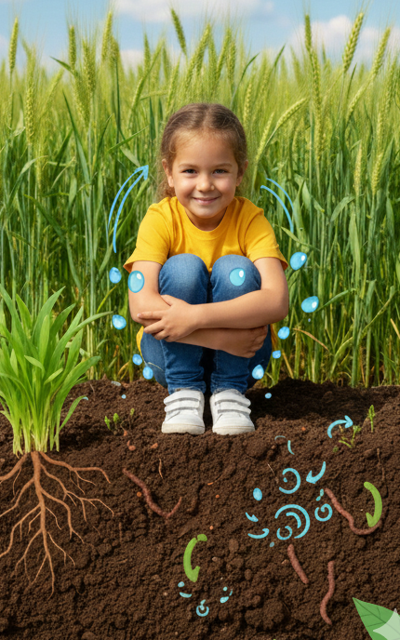
Evaporation
Stretches
Let’s act out evaporation:
Notes:
Educator Notes:
Evaporation: Have students act out evaporation as a stretch with two scenarios: hard and soft soil, with the following leading questions and instructions.
Hard Soil:
Pretend you are liquid water in a field with hard, dry soil. Remember water doesn’t absorb into this soil as well. Crouch down to be the water.
Where do you go when you are in a warm grain field? If you didn’t absorb, you evaporated. Where does evaporated water go? Stretch high, with arms wide as you evaporate into the air.
Soft Soil:
Pretend you are liquid water in a field with soft soil. Remember water absorbs well into this soil. Crouch down to be the liquid water.
Where do you go when you are in a warm grain field? How does the soil “hold you”? (Remember, soil particles in a soft field with hold the water, and act like a soft sponge to absorb and hug the water tight). Hug your body tight, big squeeze.
Does the water leave after the soil holds it tightly? Or does it hold onto the water for a while so the growing plants roots can absorb it? Continue to hug your body tight, give a small wiggle to show water moving through soil.

Slide 26

Want more?
If you need more than stretching – check out this water cycle dance
Notes:
Video source: https://www.youtube.com/watch?v=KM-59ljA4Bs

Slide 27

Show What You Know
Notes:
Educator Notes:
Have students draw a picture showing the sun shining on a puddle or a wet grain field, with arrows showing water evaporating and rising into the air. Label "Evaporation" and "Water Vapour."
Educators: Use the provided Lesson 2 exit ticket (download fromhttps://goodineverygrain.ca/2026/01/06/water-on-farms-a-six-lesson-unit-for-grade-2/ or have students record their drawings in their notebooks, on a sticky note, or on a piece of paper.
Alternatively: You can prompt some or all students to: "Tell me one way a farmer tries to keep water in the soil, even when the sun is shining and water is evaporating.”

